Slide 1
DRIVER APP

Slide 2
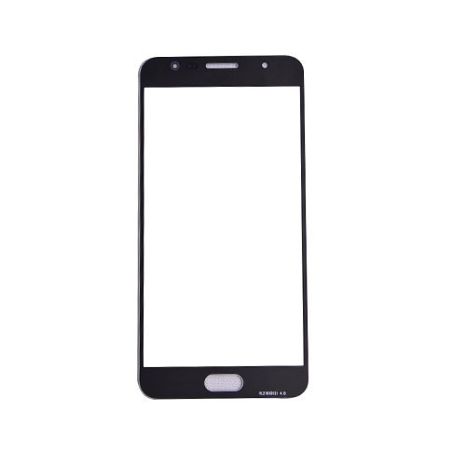

LAUNCH SCREEN

Slide 3

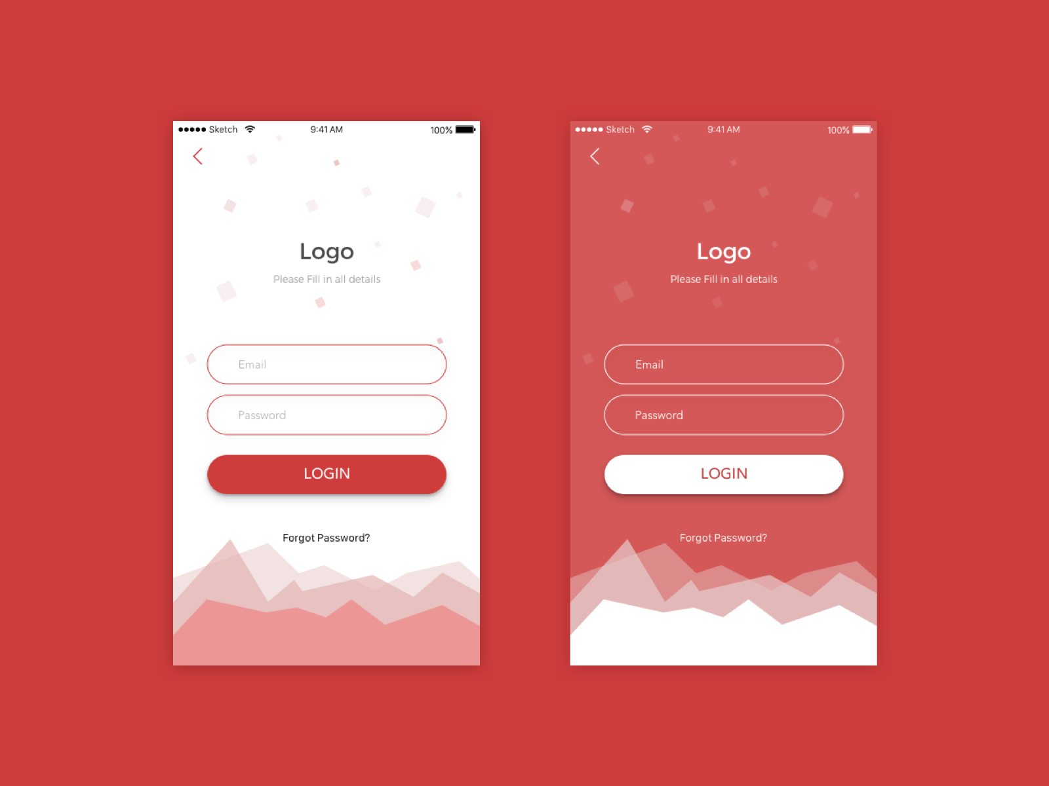



LOGIN SCREEN-2
EPOD
Transporter code
Truck No
Forgot Password

Slide 4
Invoice No
2910000029
Invoice Date
21-08-2019
Customer Name
Super Ceramic
Destination
Mumbai
Quantity
20 MT
*Remove # from Invoice number
*Replace ‘bag’ with ‘MT’ in quantity

Slide 5
2910000029
Customer Name
Super Ceramic
Customer Address
Super Ceramic,
Street 4
Mumbai
Destination
Mumbai
Quantity
20 MT
Show location icon for successful capture
Location
Location Capture
Lr Number
1111
LR Upload
Show image icon for successful upload
Customer Not Available
Submit
*Remove destination code from address

